Slide 1
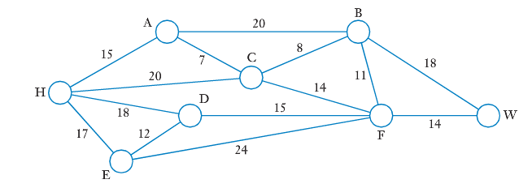
Topic: Shortest Path
EQ: What are the step by step instructions for finding the shortest path between two points?
Situation One: The diagram below shows a network of roads linking the locations of H,A,B,C,D,E,F and W, shown as circles (the circles are the vertices, not loops – the reason we are using circles will become apparent later). The number on the road (edge) is the distance between the two locations, in kms.
A motorist wished to travel from home, at H, to work, at W, by the shortest route. Which route should the motorist take and how long will it be?

Slide 2
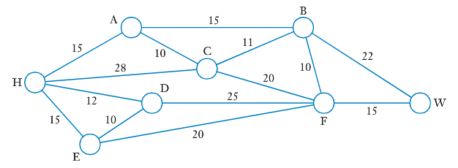
Topic: Shortest Path
EQ: What are the step by step instructions for finding the shortest path between two points?
Situation Two: After travelling by the shortest route, the motorist now realizes there may be a quicker route (road conditions, speed limits, etc...). She estimates the time it takes to travel each section of road, in minutes, shown on the diagram below
Assuming her estimations are correct, which route should she take to complete the journey from H to W as quickly as possible, and how long will it take?

Slide 3
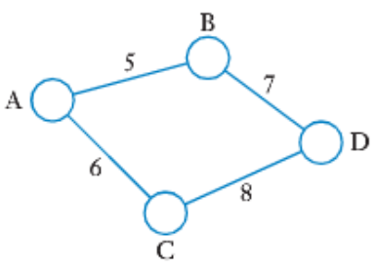
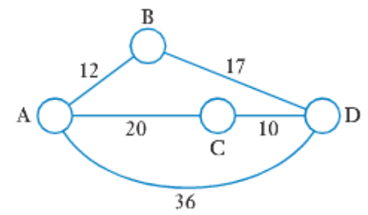
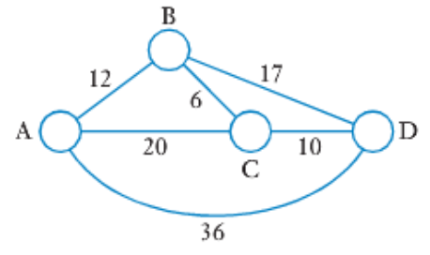
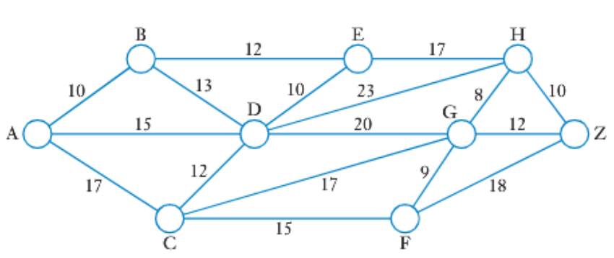
Topic: Shortest Path
EQ: What are the step by step instructions for finding the shortest path between two points?
These two situations required us to find the shortest path from one vertex to another. In one situation, shortest meant least distance and in the other, least time.
In simple networks, it can be easy to spot the shortest path, as below:
For more complicated networks, simple inspection may not be so easy, as below:
For these, we will use an algorithm to help us

Slide 4
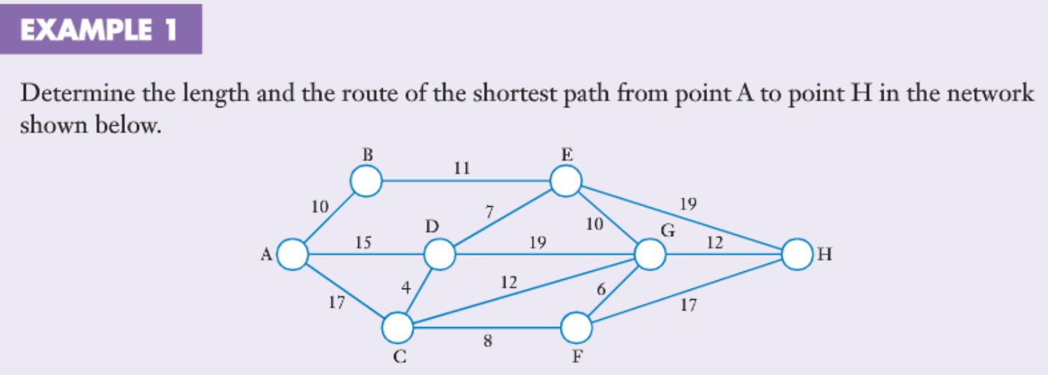
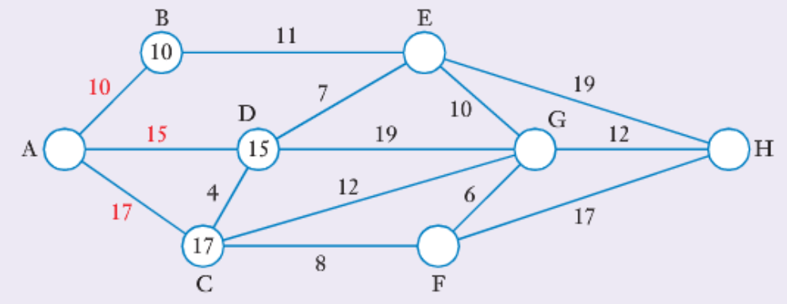
Topic: Shortest Path
EQ: What are the step by step instructions for finding the shortest path between two points?
Note that in shortest path questions, length refers to total weight, not number of edges
As we proceed from A to H, we will place a number at each vertex in turn, to indicate the length of the shortest path from A (or whatever starting point) to that vertex. We’ve also labelled that edge in red

Slide 5
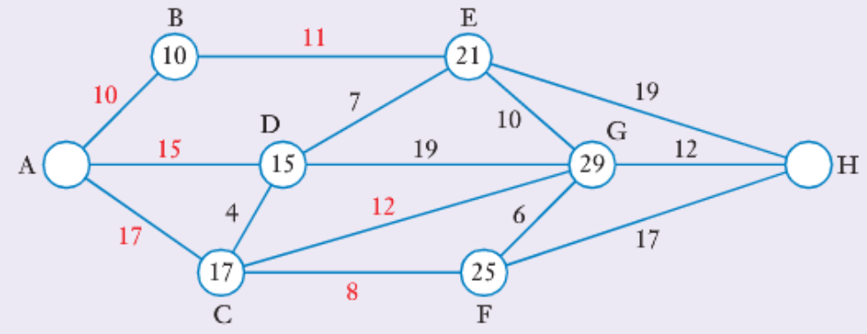
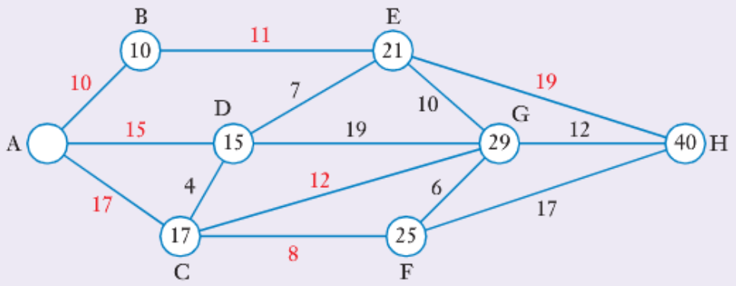
Topic: Shortest Path
EQ: What are the step by step instructions for finding the shortest path between two points?
If we continue on to E,F and G, the diagram will look like this
We can then complete the method by continuing on to point H: Thus the shortest path from A to H is 40 units. By backtracking from H back to A, along red numbers only, we see that the shortest path is H-E-B-A
Thus the shortest path is 40 units and is achieved by the route ABEH

Slide 6
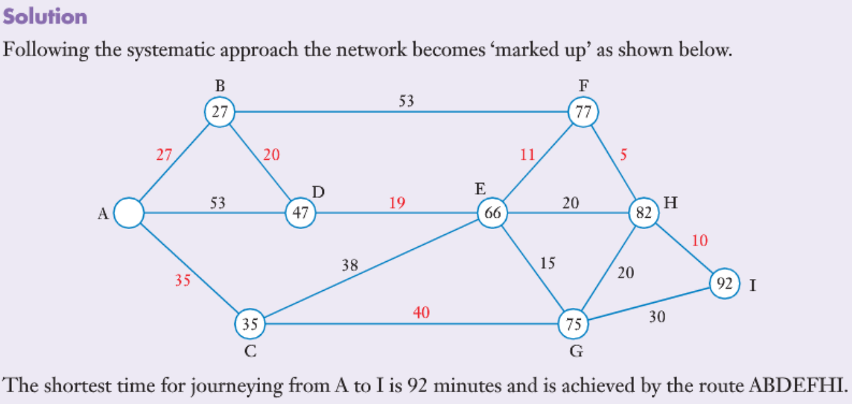
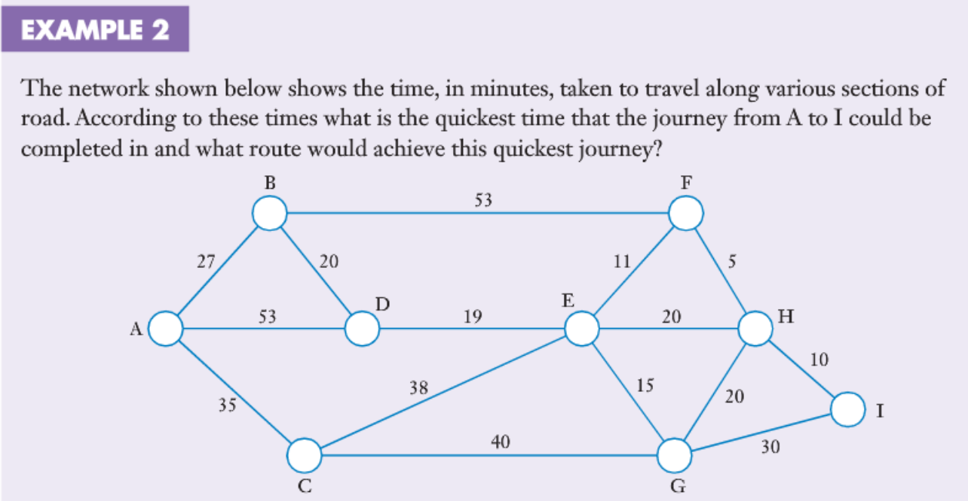
Topic: Shortest Path
EQ: What are the step by step instructions for finding the shortest path between two points?
Please complete Sadler Ch 6A Exercises

